Slide 1

Introduction to Personalised Care and Personal Health Budgets – Workshop One

Slide 2

Learning outcomes for this workshop
Explain what Personal Health Budgets are, including key principles and the national policy context.
Describe the key steps in the PHB process, from assessment to care planning, budget management and review.
Recognise how PHBs align with the NHSE 10-Year Plan and the wider personalised care agenda.
Identify the benefits of PHBs through a positive case example and understand why they matter for people and services.
Reflect on where PHBs may be relevant within their own role or area of work within the ICB.
Show how using PHBs will enable more individuals to get care and support that is more personalised

Slide 3


Slide 4
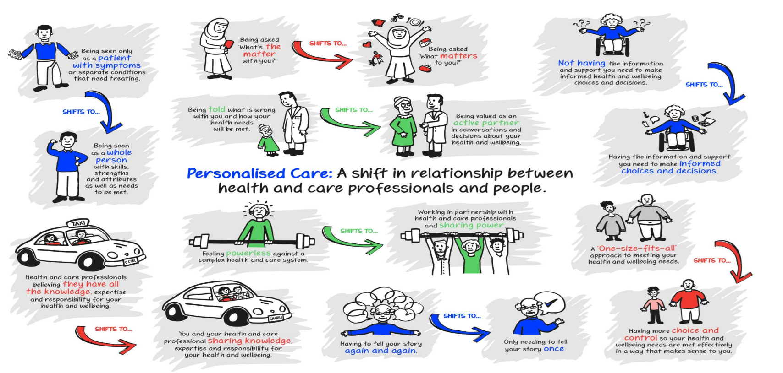

Slide 5
NHSE 10-year plan
The 10-year health plan for England, published in July 2025, recommitted to the continued expansion of PHBs, stating they have a key role in making the NHS more financially sustainable by:
UK Government, ‘Fit for the Future: 10 Year Health Plan for England’, July 2025
Expanding personalised, patient-centred care—through the Neighbourhood Health Service—and meeting the new target of offering 1 million personal health budgets by 2030, with a universal offer for everyone who could benefit by 2035

Slide 6


